Slide 1
Lecture 8
Sidra Khatoon

Slide 2
What is REST API?
A REST API (Representational State Transfer) is a set of rules that allows programs to communicate with each other using HTTP methods like GET, POST, PUT, and DELETE.
Common HTTP Methods in REST APIs:
Method | Purpose | Example Use Case
GET | Read data | Fetch list of users
POST | Create new data | Submit a new form
PUT | Update existing data | Edit user profile
DELETE | Remove existing data | Delete a user account

Slide 3
Why Use REST APIs in Flutter?
Mobile applications often rely on backend data—think weather apps, social media feeds, or shopping carts.
Flutter, by itself, doesn’t provide backend data management.
So we need APIs to retrieve and modify data stored on remote servers.

Slide 4
How does REST API work?
REST API uses simple HTTP calls to communicate with JSON data.
A user application can make GET, POST, PUT or DELETE HTTP requests to a database and send results for the query request in the response database.
The result can be in JSON, HTML, or XML, which is then parsed into the proper model class to use in the app.

Slide 5
‍REST API integration in the Flutter app
In general, you will go through the following steps for integrating an API into the Flutter application.
Get the base URL, the endpoints, and the API key.
Add required packages in-app to consume HTTP resources like http, dio, chopper, etc.
Create a constant file that will hold all your URLs and Endpoints.
Parse JSON file to get the Object out of the JSON response.
Create files to handle API calls with specific methods to fetch and parse data.
Make a method call to load data onto your UI.

Slide 6
Fetch data from the internet
Fetching data from the internet is necessary for most apps. Luckily, Dart and Flutter provide tools, such as the http package, for this type of work.
This recipe uses the following steps:
Add the http package.
Make a network request using the http package.
Convert the response into a custom Dart object.
Fetch and display the data with Flutter.

Slide 7
1. Add the http package
The http package provides the simplest way to fetch data from the internet.
To add the http package as a dependency, run flutter pub add:
$flutter pub add http
Import the http package.
import 'package:http/http.dart' as http;

Slide 8
2. Make a network request
This recipe covers how to fetch a sample album from the JSONPlaceholder using the http.get() method.
Future<http.Response> fetchAlbum() {
return http.get(Uri.parse('https://jsonplaceholder.typicode.com/albums/1'));
}
The http.get() method returns a Future that contains a Response.
Future is a core Dart class for working with async operations. A Future object represents a potential value or error that will be available at some time in the future.
The http.Response class contains the data received from a successful http call.

Slide 9
3. Convert the response into a custom Dart object
While it's easy to make a network request, working with a raw Future<http.Response> isn't very convenient. To make your life easier, convert the http.Response into a Dart object.
Create an Album class
First, create an Album class that contains the data from the network request. It includes a factory constructor that creates an Album from JSON.
Converting JSON using pattern matching is only one option.

Slide 10
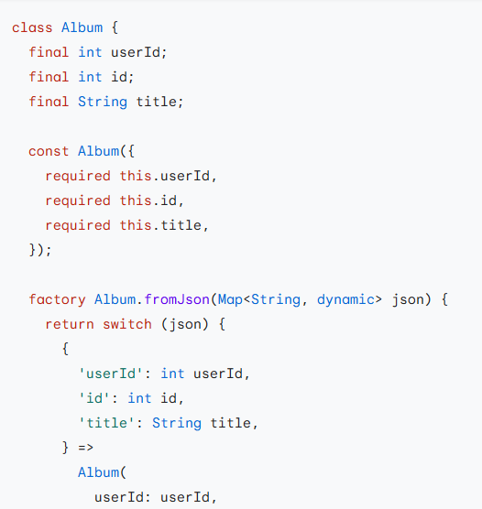
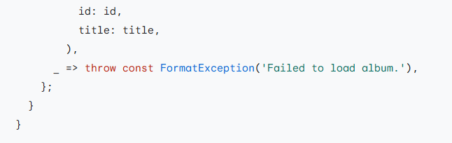

Slide 11
3. Convert the response into a custom Dart object(cont.)
Convert the http.Response to an Album
Now, use the following steps to update the fetchAlbum() function to return a Future<Album>:
Convert the response body into a JSON Map with the dart:convert package.
If the server does return an OK response with a status code of 200, then convert the JSON Map into an Album using the fromJson() factory method.
If the server does not return an OK response with a status code of 200, then throw an exception. (Even in the case of a "404 Not Found" server response, throw an exception. Do not return null. This is important when examining the data in snapshot, as shown below.)

Slide 12
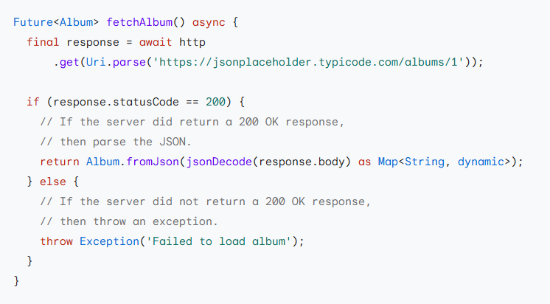

Slide 13
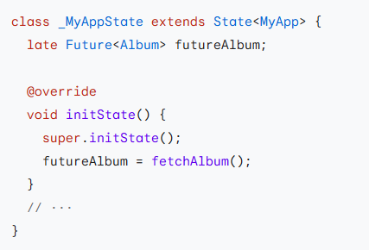
4. Fetch the data
Call the fetchAlbum() method in either the initState() or didChangeDependencies() methods.
The initState() method is called exactly once and then never again. If you want to have the option of reloading the API in response to an InheritedWidget changing, put the call into the didChangeDependencies() method

Slide 14
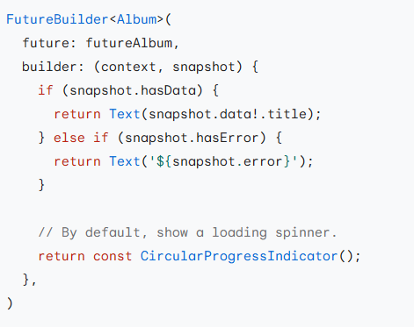
5. Display the data
To display the data on screen, use the FutureBuilder widget. The FutureBuilder widget comes with Flutter and makes it easy to work with asynchronous data sources.
You must provide two parameters:
The Future you want to work with. In this case, the future returned from the fetchAlbum() function.
A builder function that tells Flutter what to render, depending on the state of the Future: loading, success, or error.

Slide 15
Send data to the internet
Sending data to the internet is necessary for most apps. The http package has got that covered, too.
This recipe uses the following steps:
Add the http package.
Send data to a server using the http package.
Convert the response into a custom Dart object.
Get a title from user input.
Display the response on screen.
All steps are same as fetch data to the internet. Only in step 2 now we using http.post() method.

Slide 16
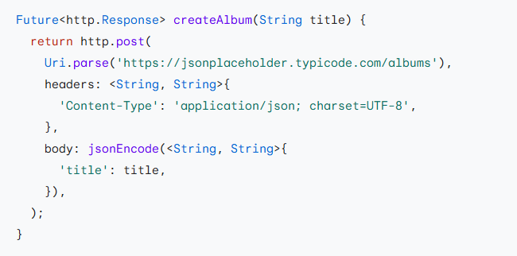
Send data to the internet
The http.post() method returns a Future that contains a Response.
Future is a core Dart class for working with asynchronous operations. A Future object represents a potential value or error that will be available at some time in the future.
The http.Response class contains the data received from a successful http call.
The createAlbum() method takes an argument title that is sent to the server to create an Album.

Slide 17
Update data over the internet
Updating data over the internet is necessary for most apps. The http package has got that covered!
This recipe uses the following steps:
Add the http package.
Update data over the internet using the http package.
Convert the response into a custom Dart object.
Get the data from the internet.
Update the existing title from user input.
Update and display the response on screen
All steps are same as fetch data to the internet. Only in step 2 now we using http.put() method.

Slide 18
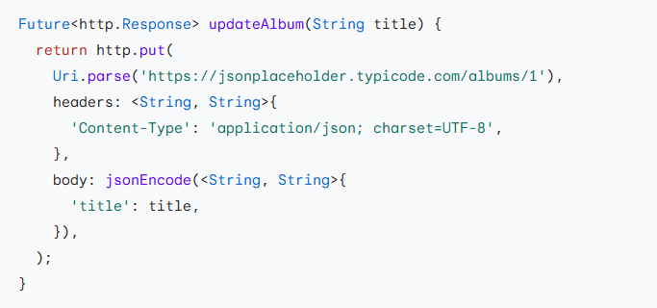
Update data over the internet
The http.put() method returns a Future that contains a Response.
Future is a core Dart class for working with async operations. A Future object represents a potential value or error that will be available at some time in the future.
The http.Response class contains the data received from a successful http call.
The updateAlbum() method takes an argument, title, which is sent to the server to update the Album.

Slide 19
Delete data on the internet
This recipe covers how to delete data over the internet using the http package.
This recipe uses the following steps:
Add the http package.
Delete data on the server.
Update the screen..
Step 1 is same as get data from internet. Only in step 2 now we using http.delete() method.

Slide 20
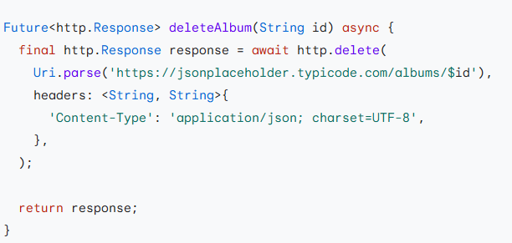
Delete data on the internet
The http.delete() method returns a Future that contains a Response.
Future is a core Dart class for working with async operations. A Future object represents a potential value or error that will be available at some time in the future.
The http.Response class contains the data received from a successful http call.
The deleteAlbum() method takes an id argument that is needed to identify the data to be deleted from the server.

